Slide 1


CNPC Niger Petroleum S.A.
Computer Basics & Practical Soft Skills
CNPC Niger Petroleum S.A. CNPC Global Solutions Co. Ltd

Slide 2

Training Agenda
Lecture 1 : Foundations & Professional Communication
Lecture 2 : Data, Presentation & Productivity
Lecture 3 : Business Systems & Problem Solving

Slide 3

Training Objectives
After finalizing this training you should be able to
Computer Hardware: Identify components, connect peripherals, and perform basic troubleshooting.
Excel: Use essential formulas, sort/filter data, and create basic charts.
PowerPoint: Create clean, professional slides and insert objects (images, charts).
Word: Apply consistent formatting (styles, headers) and use Track Changes.
Outlook: Write professional emails, organize their inbox, and manage their calendar.
ERP: Define what an ERP system is and explain its purpose in the business.
Workplace Etiquette: Demonstrate professional conduct in physical and virtual settings.
Communication: Practice active listening and communicate ideas clearly.
Professional Ethics: Understand the importance of integrity, confidentiality, and accountability.
Time Management: Prioritize tasks effectively and plan their workday.
Problem Solving: Apply a structured approach to identify and solve workplace problems.

Slide 4

Test your Knowledge
Please scan the QR code here or go to the below website:
https://afathelbab.github.io/cnpc/computer-basics-soft-skills/day3/quiz.html

Slide 5

Quiz Reflection
How many got the full mark?
How got more than 50% correct?
How many got them all wrong?
It’s OK either way

Slide 6
Module 1:
Introduction to ERP Systems

Slide 7


Module 1: Introduction to ERP Systems
What is an ERP System?
ERP stands for Enterprise Resource Planning.
At its simplest, an ERP is a single, centralized software system that manages all of a company's key business processes.
It acts as the "central nervous system" for the entire business

Slide 8
Module 1: Introduction to ERP Systems
What is an ERP System?
Think about all the different departments in our company:
Operations (manages well sites, production schedules)
Maintenance (handles work orders, equipment repair)
Supply Chain (handles inventory, ordering parts, shipping)
Finance (handles billing, payments, accounts)
HR (handles employee info, payroll, hiring)
HSE (handles safety permits, incident reporting)
In the past, each department might have used its own separate software. This creates "silos," where data is hard to share, must be manually re-entered, and quickly becomes out-of-date.

Slide 9
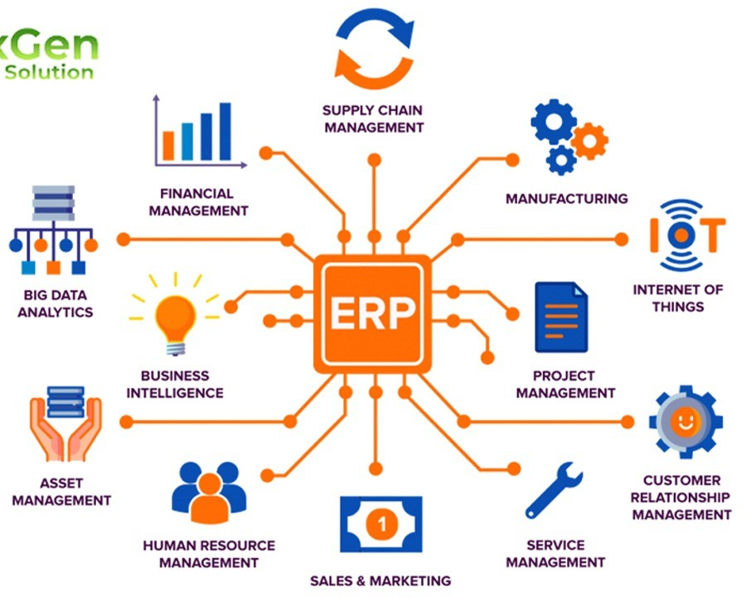
Module 1: Introduction to ERP Systems
The Purpose of an ERP: A Single Source of Truth
The main purpose of an ERP system is to break down those silos.
It creates a "single source of truth" by having all departments use one shared, central database.
When everyone uses the same system, data is shared in real-time.

Slide 10
Module 1: Introduction to ERP Systems
The Purpose of an ERP: A Single Source of Truth
Let's trace a single maintenance task to see how the ERP connects everyone from the field to the warehouse.
We'll use a "Procure-to-Pay" example.

Slide 11
Module 1: Introduction to ERP Systems
How an ERP Works: (Procure-to-Pay)
Let's trace a single maintenance task to see how the ERP connects everyone from the field to the warehouse.
We'll use a "Procure-to-Pay" example.

Slide 12
Module 1: Introduction to ERP Systems
How an ERP Works: (Procure-to-Pay)
Maintenance:
A supervisor inspects a pump (P-101) and sees it needs a new strainer. They create a purchase requisition in the ERP for that specific part number.

Slide 13
Module 1: Introduction to ERP Systems
How an ERP Works: (Procure-to-Pay)
Procurement (Supply Chain):
The requisition is automatically routed to the procurement team. They see the request, check the system, and confirm the part is not in the warehouse. They issue a Purchase Order (PO) to an approved vendor.

Slide 14
Module 1: Introduction to ERP Systems
How an ERP Works: (Procure-to-Pay)
Warehouse (Supply Chain):
The vendor delivers the part. The warehouse team receives it, scans it, and marks it as "Goods Received" in the ERP. The system inventory is immediately updated.

Slide 15
Module 1: Introduction to ERP Systems
How an ERP Works: (Procure-to-Pay)
Finance:
The "Goods Received" status, matched with the vendor's invoice, automatically triggers the ERP to approve the payment. Finance doesn't have to ask maintenance if the part arrived—they know.

Slide 16
Module 1: Introduction to ERP Systems
How an ERP Works: (Procure-to-Pay)
Maintenance (Again):
The supervisor who made the request now sees the part is "In Stock" and can create a Work Order to have it installed.
Everyone is working from the same, up-to-date information.

Slide 17
Module 1: Introduction to ERP Systems
Benefits of an ERP
Efficiency: No more re-typing data from one system into another.
Accuracy: Reduces errors by having one source for all data.
Better Reporting: Managers can see a complete picture of the business in one place.
Consistency: A customer gets the same information no matter which department they talk to.

Slide 18
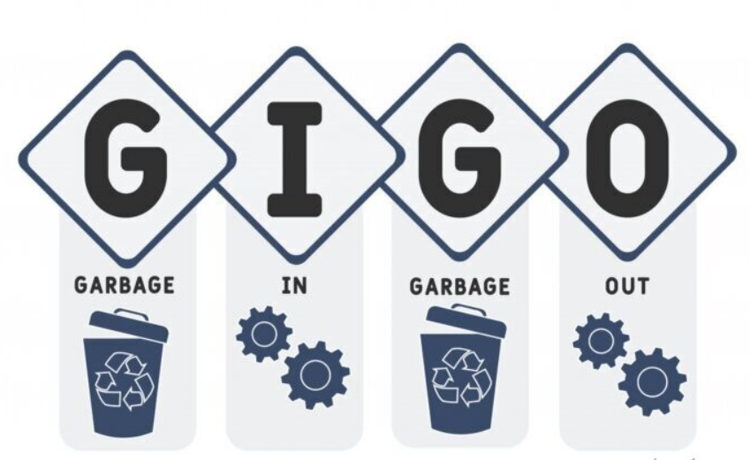
Module 1: Introduction to ERP Systems
The GIGO Effect
The ERP is only as good as the data put into it.
A single typo in a part number, a Well ID, or a dollar amount can cause major problems for many other departments (e.g., ordering the wrong part, billing to the wrong project).
Your responsibility, any time you use the ERP, is to be accurate and timely. Double-check your entries.
The "single source of truth" depends on every single user.

Slide 19

Module 1: Introduction to ERP Systems
Open Discussion
Why is having a "single source of truth" for data so important for a growing business?
Before ERPs, what kind of problems might a company have if Sales, Finance, and Shipping all used different software?

Slide 20
Module 2:
Problem Solving

Slide 21

Module 2: Problem Solving
A Structured Approach to Problem Solving
Problems will come up. It's a normal part of work.
The key isn't to avoid problems, but to have a clear method for solving them effectively.
Here is a simple 4-step approach you can apply to almost any workplace problem.
1. Define the Real Problem
2. Brainstorm Potential Solutions
3. Evaluate and Choose a Solution
4. Implement and Review

Slide 22

Module 2: Problem Solving
Define the Real Problem
Don't just fix the symptom; find the root cause.
Symptom: "A critical pump (P-101) is down, stopping production.“
Real Problem: "The scheduled preventive maintenance (PM) wasn't done.“

Slide 23
Module 2: Problem Solving
Define the Real Problem
Root Cause (Keep asking "Why?"):
1. Why was the PM not done?
"The maintenance team didn't have the filter replacement part."
2. Why?
"The part wasn't ordered."
3. Why?
"The inventory system said we had 2 in stock, but the shelf was empty."
4. Why?
"The last part was used for an emergency repair on P-102, and the inventory wasn't updated."
5. Why?
"The technician who took the part was covering a night shift and forgot to log the removal in the system."
  Root Cause: "Our process for removing inventory on off-hours is not being followed."

Slide 24

Module 2: Problem Solving
Brainstorm Potential Solutions
Now that you know the root cause, what are some ways to fix it?
Don't judge ideas at this stage. Write everything down.
Example (for the root cause above):
  Implement a barcode scanner at the warehouse door (Must scan part and badge).
  Do a full re-training session on the inventory procedure.
  Put a physical, mandatory sign-out sheet on the warehouse shelf for "after-hours" use.
  Lock the parts warehouse after 5 PM; all parts must be requested from a supervisor.

Slide 25
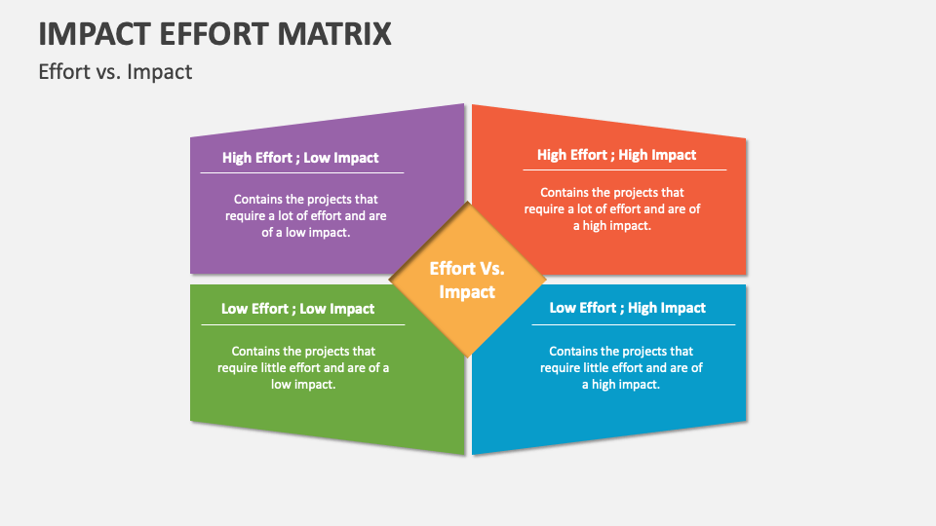
Module 2: Problem Solving
Evaluate and Choose a Solution
Look at your list of solutions and pick the best one(s).
A simple "Effort vs. Impact" matrix is a great tool
 | Low Impact | High Impact
High Effort | Thankless Tasks (Avoid these) | Fill-ins (Do if you have time)
Low Effort | Major Projects (Plan these) | Quick Wins! (Do these first)

Slide 26

Module 2: Problem Solving
Evaluate and Choose a Solution
Analysis:
Barcode scanner:
(High Effort, High Impact) -> Major Project.
Re-training:
(Medium Effort, Medium Impact)
Physical sign-out sheet:
(Low Effort, High Impact) -> Quick Win!
Lock warehouse:
(High Effort, Low Impact) -> Thankless Task (causes other problems).

Slide 27
Module 2: Problem Solving
Evaluate and Choose a Solution
Decision:
Let's
Add the physical sign-out sheet immediately (Quick Win)
and
schedule the barcode scanner as a long-term project.

Slide 28

Module 2: Problem Solving
Implement and Review
Put your chosen solution into action. But you're not done yet.
Implement: The warehouse manager creates and places the sign-out sheet. An email is sent to all supervisors about the new temporary rule.
Review: Check back in a month. Run an inventory report. "Have our 'system vs. actual' inventory counts improved?" If yes, it worked. If no, it didn't. This step is critical.
This structured process helps you avoid panic and find a solution that lasts.

Slide 29
Module 2: Problem Solving
Open Discussion
Why is it so important to correctly define the problem (Step 1) before trying to brainstorm solutions (Step 2)?
Think of a simple, common problem (e.g., "We keep running out of printer paper in the breakroom"). How would you apply these 4 steps?

Slide 30
Test your Knowledge
Again!
Please scan the QR code here or go to the below website:
https://afathelbab.github.io/cnpc/computer-basics-soft-skills/day3/quiz.html

Slide 31
Workshop

Slide 32
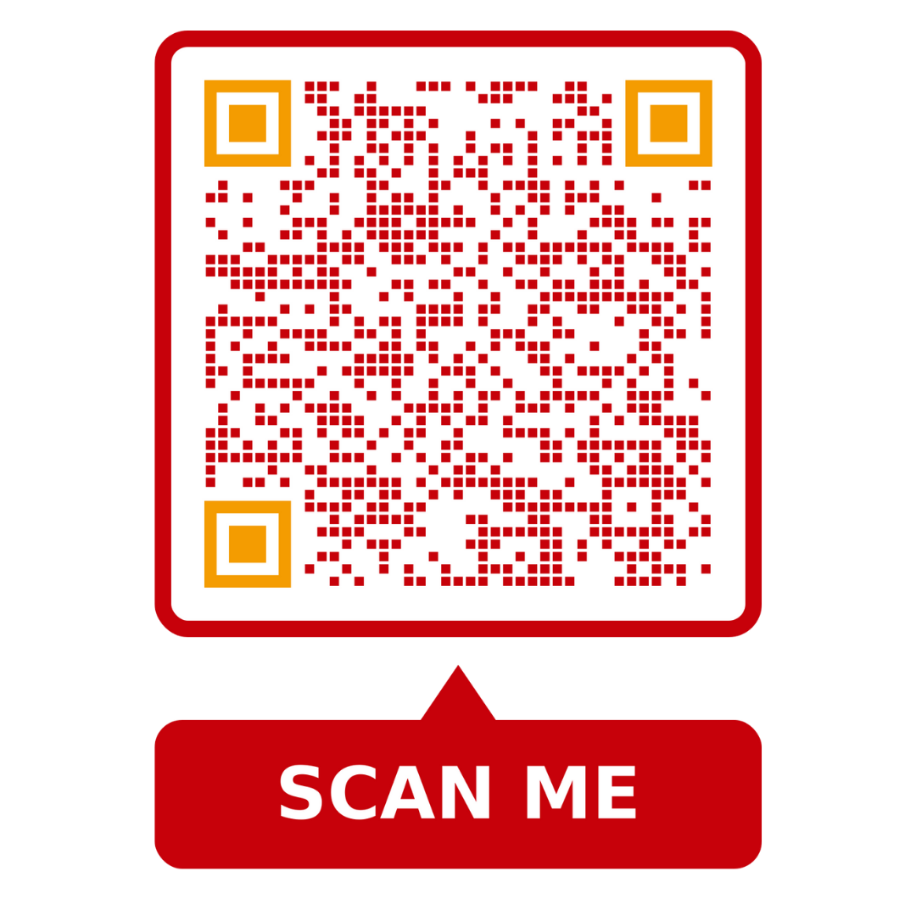

Workshop
https://afathelbab.github.io/cnpc/computer-basics-soft-skills/workshops/

Slide 33



A Better You, A Better Niger
74

